Slide 1
Announcements
Midterm 1: Almost done grading. Will be returned by the end of the week.
Probability Review Sessions
See Piazza post
Project 3: Reinforcement Learning
Due Friday 10/14 at 5pm
Contest 2: Due Sunday 10/16 at 11:59pm
Homework 6: Probability and Bayes’ Nets
Due Monday 10/17 at 11:59.pm
Notes:
My office hours?

Slide 2
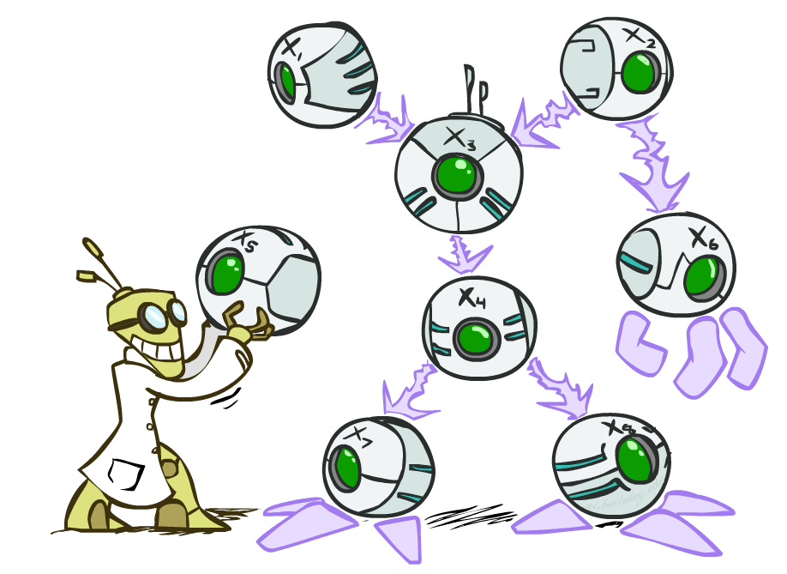
CS 188: Artificial Intelligence
Bayes’ Nets
Instructors: Josh Hug & Adam Janin --- University of California, Berkeley
[These slides were created by Dan Klein, Pieter Abbeel, Anca Dragan, Adam Janin for CS188 Intro to AI at UC Berkeley. All CS188 materials are available at http://ai.berkeley.edu.]
Notes:
Please retain proper attribution, including the reference to ai.berkeley.edu. Thanks!
Next 4 lectures.

Slide 3

Probabilistic Models
Models describe how (a portion of) the world works
Models are always simplifications
May not account for every variable
May not account for all interactions between variables
“All models are wrong; but some are useful.” – George E. P. Box
What do we do with probabilistic models?
We (or our agents) need to reason about unknown variables, given evidence
Example: explanation (diagnostic reasoning)
Example: prediction (causal reasoning)
Example: value of information
Notes:
Broken record. Do you folks still know what that means?
Prediction: Possible futures. Simple example: I say ”the cat”. Prob of “is” vs. “orange”.
Highly valuable info – next week lottery – value of getting that measurement.

Slide 4

Independence
Notes:
How many outcomes of flipping 30 coins? 2^30. Intractable. Do you have to ennumerate?

Slide 5
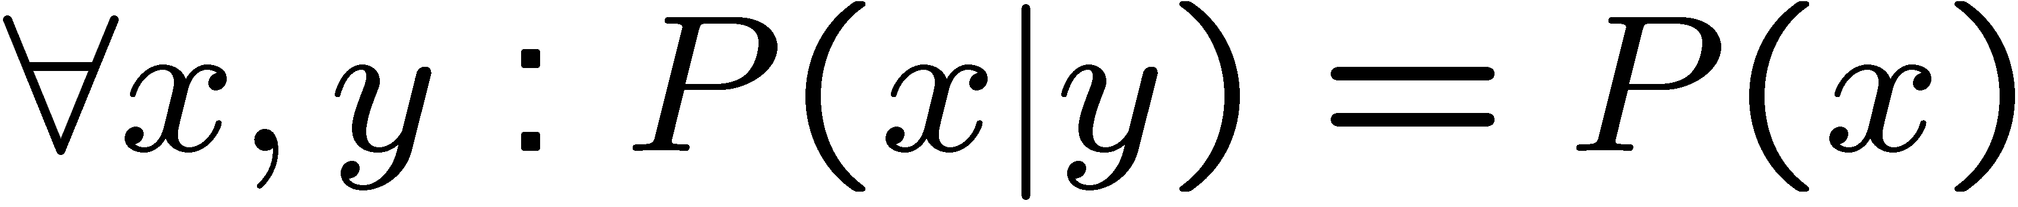
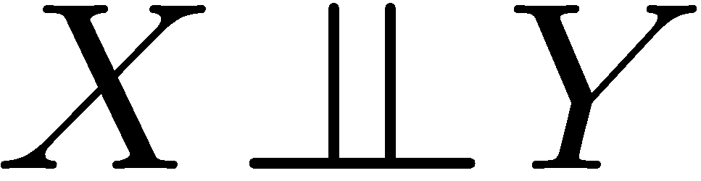
Independence
Two variables are independent if:
This says that their joint distribution factors into a product two simpler distributions
Another form:
We write:
Independence is a simplifying modeling assumption
Empirical joint distributions: at best “close” to independent
Notes:
Hopefully mostly review. Product of marginal.

Slide 6
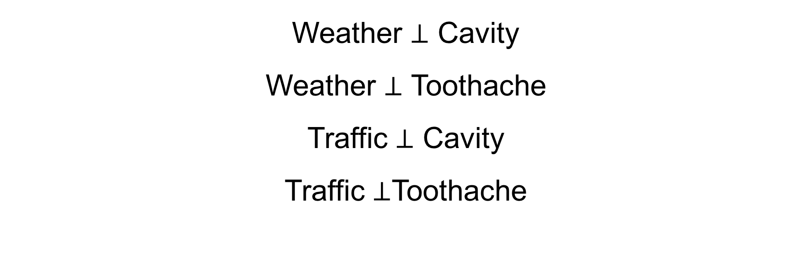
Independence?
What could we assume for {Weather, Traffic, Cavity, Toothache}?
Weather $⊥$ Cavity
Weather $⊥$ Toothache
Traffic $⊥$ Cavity
Traffic $⊥$Toothache
Notes:
Assume we WANT to simplify

Slide 7
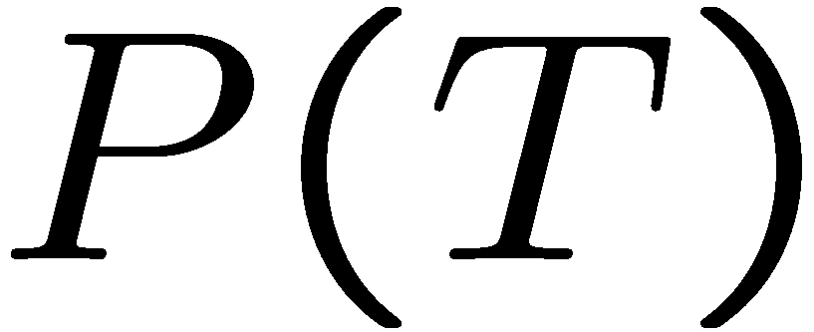
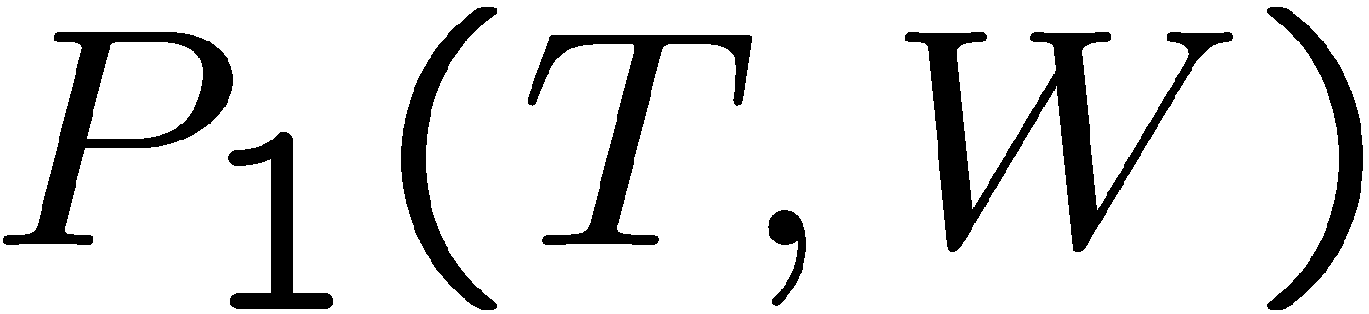
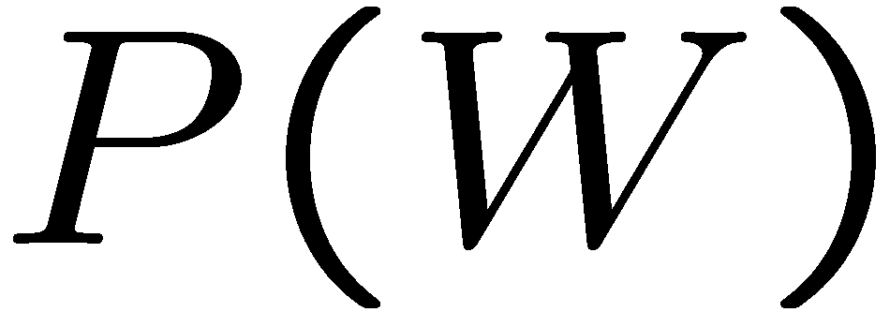
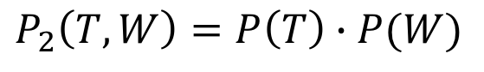
Testing Independence
T | P
hot | 0.5
cold | 0.5
$$P_{2}\left(T, W\right)=P\left(T\right)∙P(W)$$
T | W | P
hot | sun | 0.4
hot | rain | 0.1
cold | sun | 0.2
cold | rain | 0.3
T | W | P
hot | sun | 0.3
hot | rain | 0.2
cold | sun | 0.3
cold | rain | 0.2
W | P
sun | 0.6
rain | 0.4

Slide 8


Example: Independence
N fair, independent coin flips:
H | 0.5
T | 0.5
H | 0.5
T | 0.5
H | 0.5
T | 0.5
Notes:
How much memory for tables on top vs. bottom.
Catch: why would we bother to form joint? Too simple. This is extreme case of all indep.
Hints at where we’re going – some indep gives some compress.

Slide 9
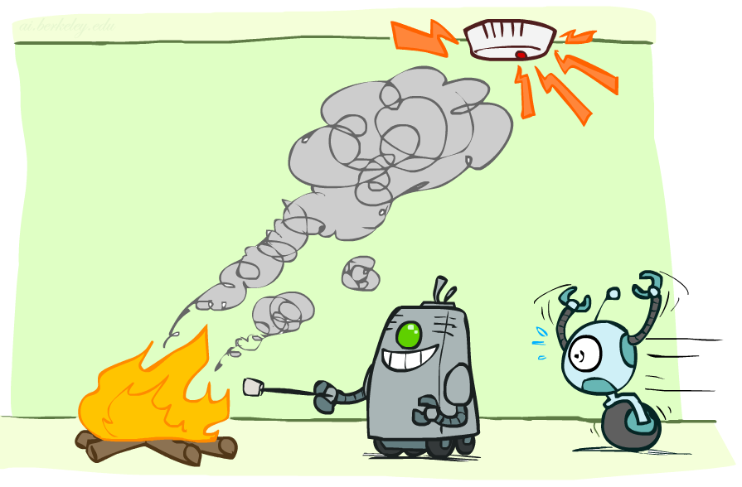
Conditional Independence

Slide 10
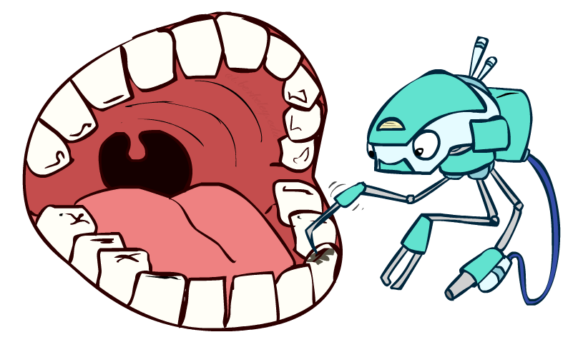
Conditional Independence
P(Toothache, Cavity, Catch)
If I have a cavity, the probability that the probe catches in it doesn't depend on whether I have a toothache:
P(+catch | +toothache, +cavity) = P(+catch | +cavity)
The same independence holds if I don’t have a cavity:
P(+catch | +toothache, -cavity) = P(+catch| -cavity)
Catch is conditionally independent of Toothache given Cavity:
P(Catch | Toothache, Cavity) = P(Catch | Cavity)
Equivalent statements:
P(Toothache | Catch , Cavity) = P(Toothache | Cavity)
P(Toothache, Catch | Cavity) = P(Toothache | Cavity) P(Catch | Cavity)
One can be derived from the other easily
Notes:
~9:50
Intuitive

Slide 11
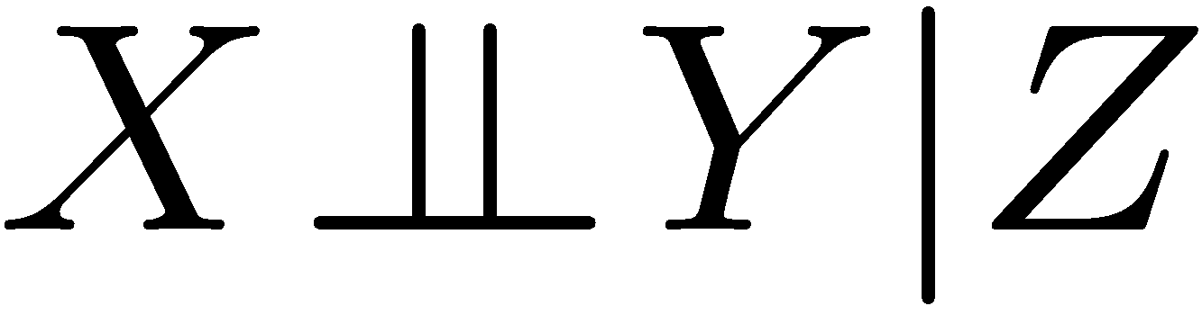
Conditional Independence
Unconditional (absolute) independence very rare (why?)
Conditional independence is our most basic and robust form of knowledge about uncertain environments.
X is conditionally independent of Y given Z
if and only if:
or, equivalently, if and only if
Notes:
Formal
Catch, Toothache | Cavity

Slide 12
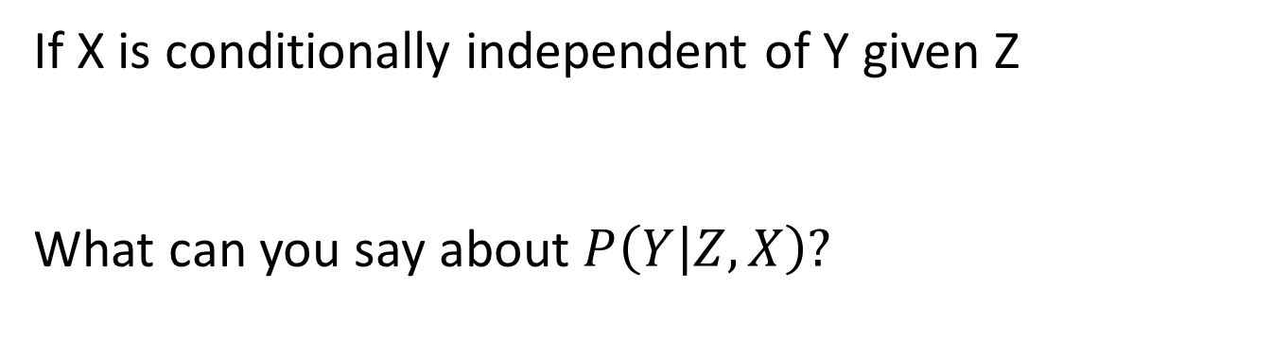
Conditional Independence
If X is conditionally independent of Y given Z
What can you say about $P\left(Y | Z,X\right)?$
Notes:
Catch ortho to toothache given cavity
Prob of toothache given cavity and catch?

Slide 13
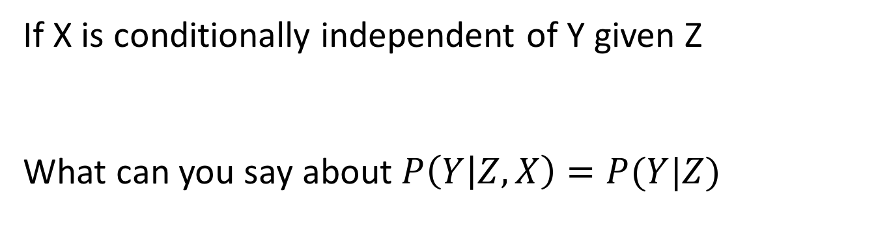
Conditional Independence
If X is conditionally independent of Y given Z
What can you say about $P\left(Y | Z,X\right)=P(Y|Z)$
Notes:
Prob of toothache given cavity and catch?
Prob of toothache given cavity. Catch is no extra info.

Slide 14
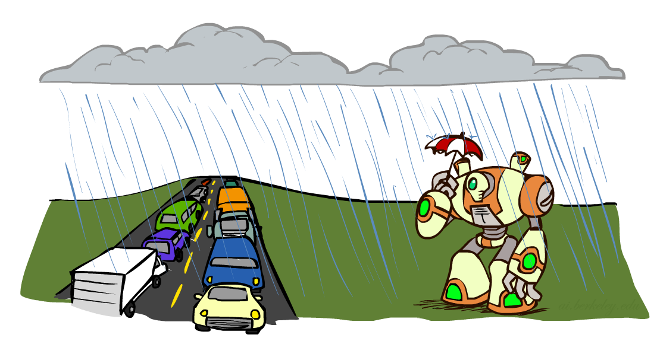
Conditional Independence
What about this domain:
Traffic
Umbrella
Raining

Slide 15

Conditional Independence
What about this domain:
Traffic
Umbrella
Raining
$$U⊥T ?$$

Slide 16

Conditional Independence
What about this domain:
Traffic
Umbrella
Raining
$$U⊥T | R$$

Slide 17

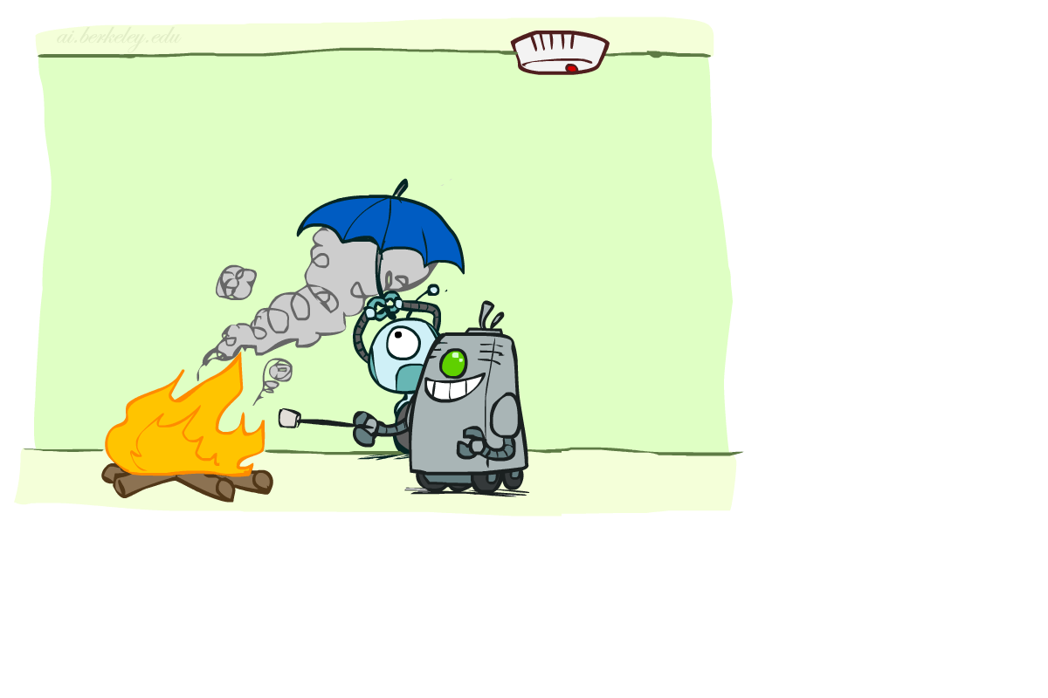

Conditional Independence
What about this domain:
Fire
Smoke
Alarm
$$F⊥A | S$$
Notes:
~10:00
A bit more tricky. Need model. What’s the cute diagram tell us about the alarm?

Slide 18

Conditional Independence and the Chain Rule
Chain rule:
Trivial decomposition:
With assumption of conditional independence:
Bayes’nets / graphical models help us express conditional independence assumptions

Slide 19

Conditional Independence and the Chain Rule
Chain rule:
P(Traffic, Rain, Umbrella) =
P(Traffic) P(Rain|Traffic) P(Umbrella|Traffic, Rain)
P(Traffic, Rain, Umbrella) =
P(Umbrella) P(Traffic|Umbrella) P(Rain| Umbrella, Traffic)
P(Traffic, Rain, Umbrella) =
P(Rain) P(Traffic|Rain) P(Umbrella|Rain, Traffic)
But we said $U⊥T | R!$

Slide 20

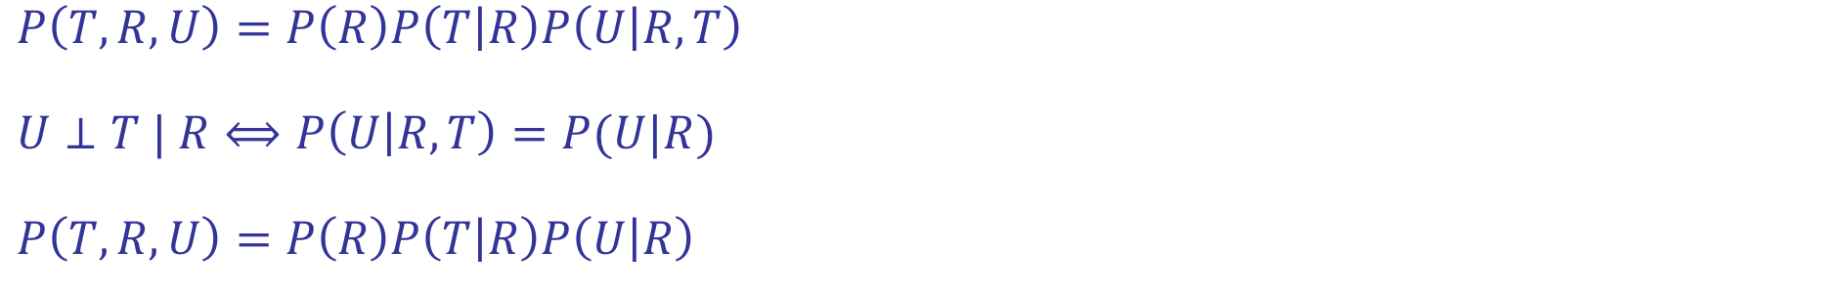
Conditional Independence and the Chain Rule
$$P\left(T,R,U\right)=P\left(R\right)P\left(T | R\right)P\left(U | R,T\right)$$
$$U⊥T | R⟺P\left(U | R,T\right)=P(U|R)$$
$$P\left(T,R,U\right)=P\left(R\right)P\left(T | R\right)P\left(U | R\right)$$
Notes:
Makes me a happy robot! Smaller tables. Not a big deal in this example, but adds up.
This is what Bayes’ Nets are all about. Chain rule, cond indep, compression.

Slide 21
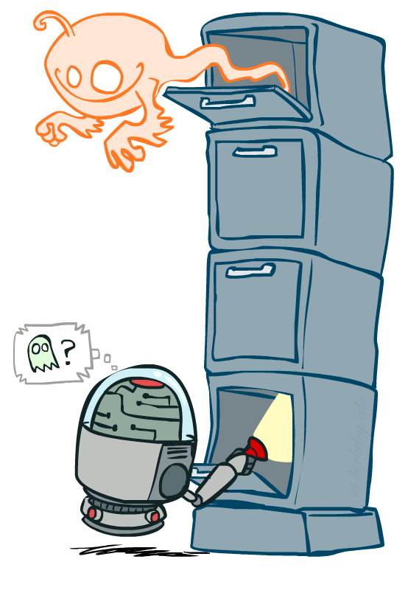
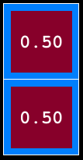
Ghostbusters Chain Rule
Each sensor depends only on where the ghost is
That means, the two sensors are conditionally independent, given the ghost position
T: Top square is red B: Bottom square is red G: Ghost is in the top
Givens:
P( +g ) = 0.5
P( -g ) = 0.5
P( +t | +g ) = 0.8 P( +t | -g ) = 0.4 P( +b | +g ) = 0.4 P( +b | -g ) = 0.8
P(T,B,G) = P(G) P(T|G) P(B|G)
T | B | G | P(T,B,G)
+t | +b | +g | 0.16
+t | +b | -g | 0.16
+t | -b | +g | 0.24
+t | -b | -g | 0.04
-t | +b | +g | 0.04
-t | +b | -g | 0.24
-t | -b | +g | 0.06
-t | -b | -g | 0.06
Notes:
Another example from last week. Random Variables BINARY T,B,G
Why not one variable for which is red? Noise in sensor.
Model has 6 numbers. Full table need 2^3 entries.
Break if < 10:10 to about 10:13

Slide 22
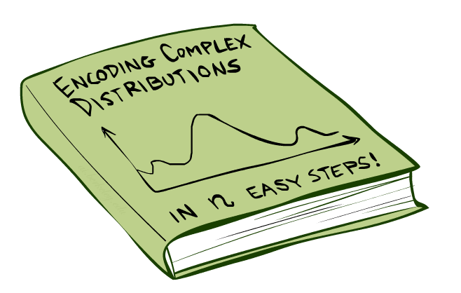
Bayes’Nets: Big Picture

Slide 23

Bayes’ Nets: Big Picture
Two problems with using full joint distribution tables as our probabilistic models:
Unless there are only a few variables, the joint is WAY too big to represent explicitly
Hard to learn (estimate) anything empirically about more than a few variables at a time
Bayes’ nets: a technique for describing complex joint distributions (models) using simple, local distributions (conditional probabilities)
More properly called graphical models
We describe how variables locally interact
Local interactions chain together to give global, indirect interactions
For about 10 min, we’ll be vague about how these interactions are specified
Notes:
What should the numbers be, even if you were willing? Hard to spec or learn.

Slide 24
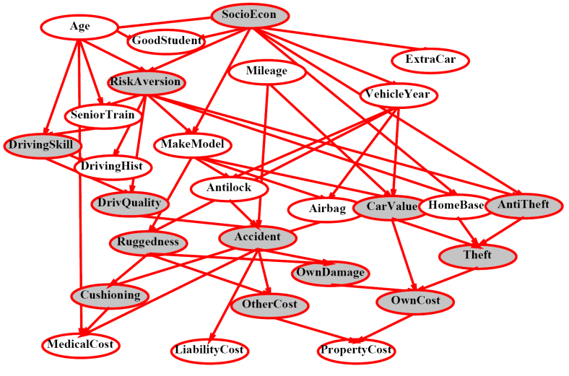
Example Bayes’ Net: Insurance
Notes:
Direct vs. mediated.

Slide 25
Example Bayes’ Net: Car
Notes:
Battery flat – battery may work, but not charging.
Causal model very common. Not necessary.
If car doesn’t start, and you observe all the green, what’s the prob you’re out of gas?

Slide 26
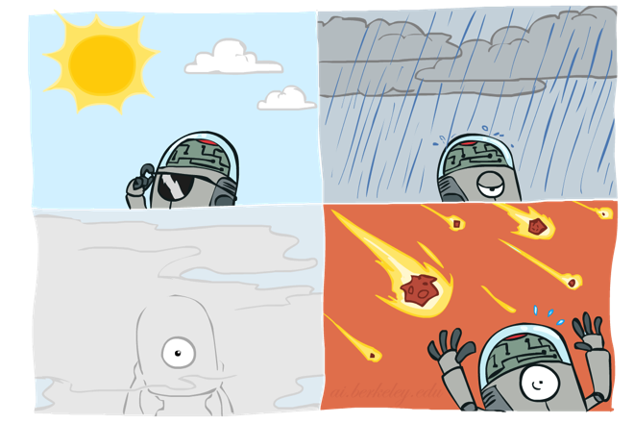
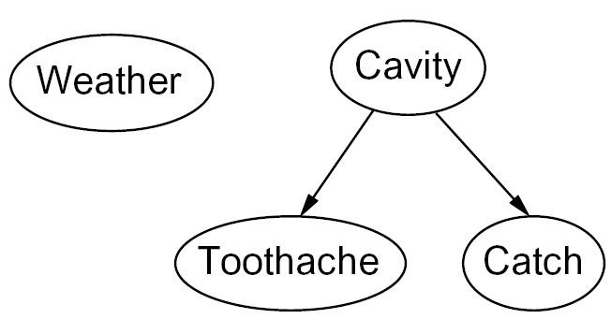
Graphical Model Notation
Nodes: variables (with domains)
Can be assigned (observed) or unassigned (unobserved)
Arcs: interactions
Similar to CSP constraints
Indicate “direct influence” between variables
Formally: encode conditional independence (more later)
For now: imagine that arrows mean direct causation (in general, they don’t!)
Notes:
More formal.

Slide 27
Example: Coin Flips
N independent coin flips
No interactions between variables: absolute independence
X₁
X₂
X_{n}
Notes:
~10:20

Slide 28
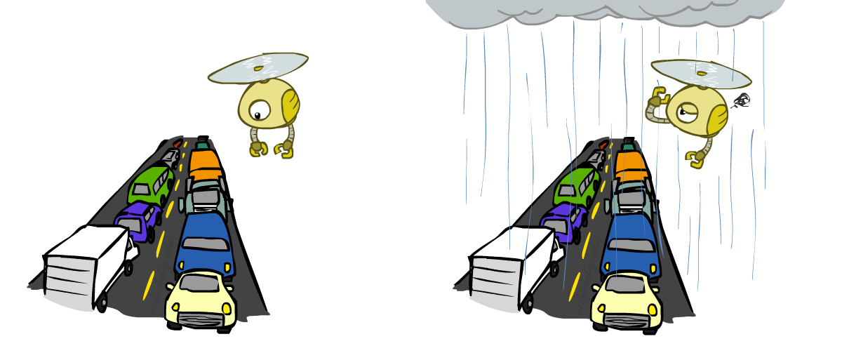
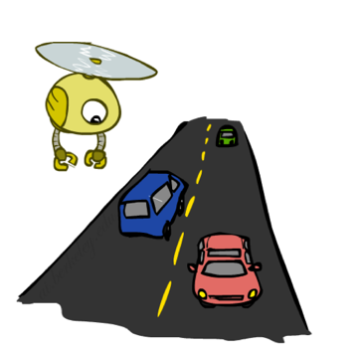
Example: Traffic
Variables:
R: It rains
T: There is traffic
Model 1: independence
When is an agent using model 2 better?
Model 2: rain causes traffic
R
R
T
T
Notes:
Valid? How about in a long tunnel?
Random variables. Probs on them P(rain) vs. P(-rain). P(heavy traffic | rain), P(light traffic | -rain), etc.

Slide 29
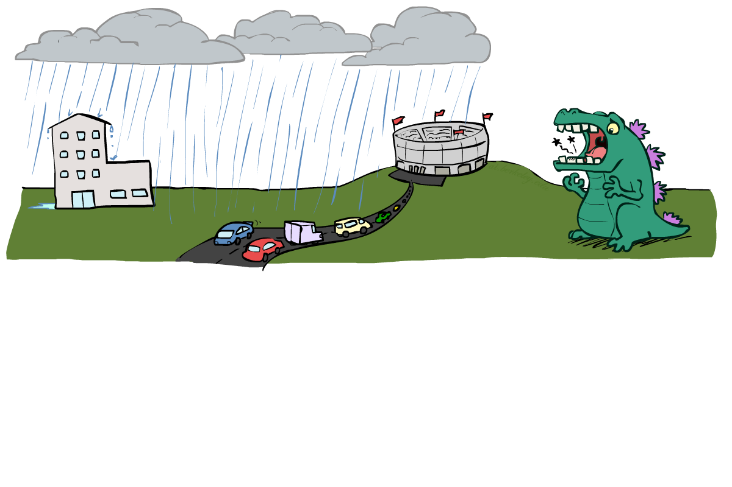
Example: Traffic II
Let’s build a causal graphical model!
Variables
T: Traffic
R: It rains
L: Low pressure
D: Roof drips
B: Ballgame
C: Cavity

Slide 30
Example: Traffic II
Let’s build a causal graphical model!
Variables:
T: Traffic
R: It Rains
L: Low Pressure
C
D
B
D: Roof Drips
B: Ball Game
L
R
T
C: Cavity
Notes:
Think about numbers on this graph. P(heavy traffic | rain, -ballgame)

Slide 31
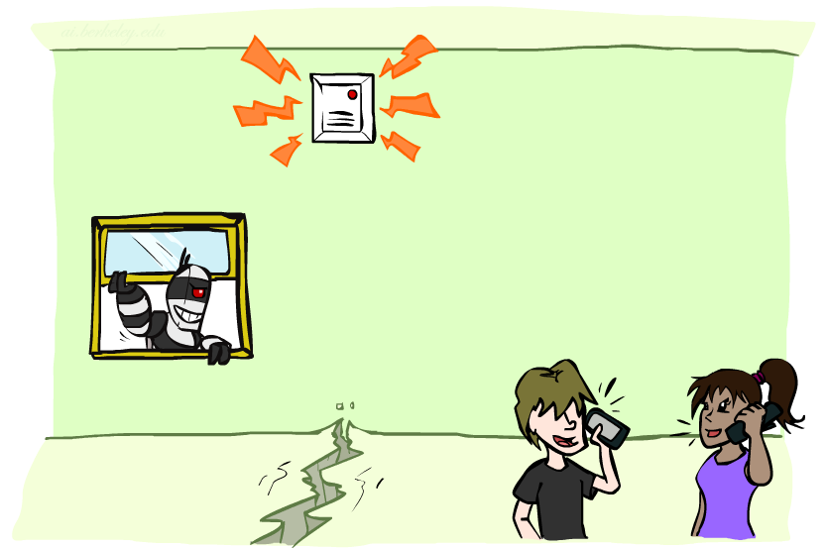
Bayes’ Network for Alarm Network?
Variables
B: Burglary
A: Alarm goes off
M: Mary calls
J: John calls
E: Earthquake!
Model Assumptions
Alarm can go off if Burglary or Earthquake
Mary and John call if they hear the alarm
Notes:
Neighbors Mary and John can’t see your house.

Slide 32
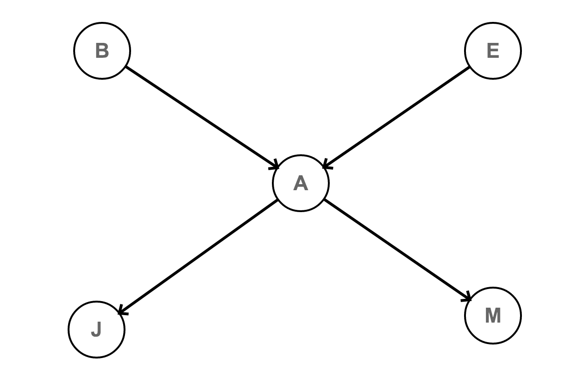
Bayes’ Network for Alarm Network?
Variables
B: Burglary
A: Alarm goes off
M: Mary calls
J: John calls
E: Earthquake!
Model Assumptions
Alarm can go off if Burglary or Earthquake
Mary and John call if they hear the alarm
Notes:
Neighbors Mary and John can’t see your house.

Slide 33
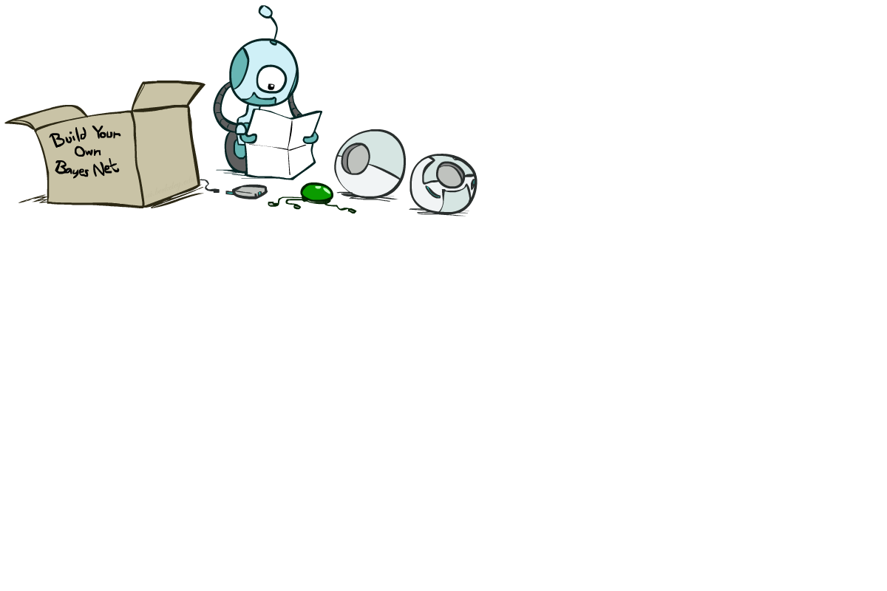
Bayes’ Net Semantics
Notes:
Formalisms.

Slide 34
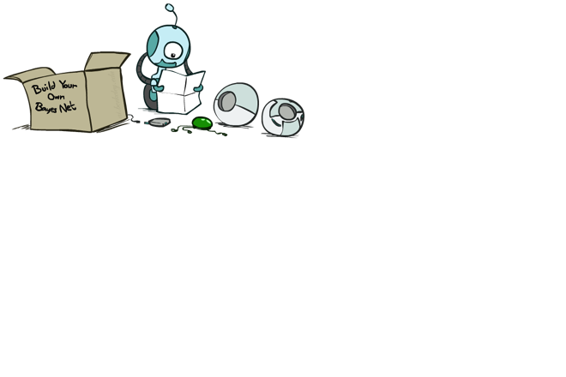
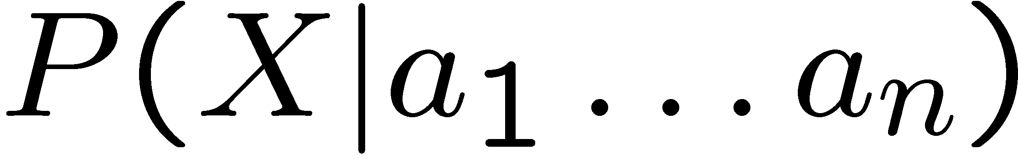
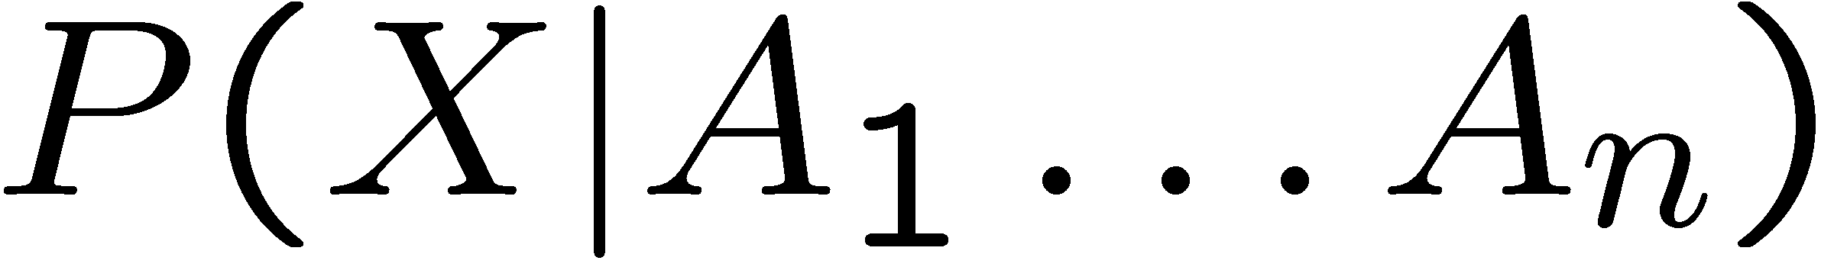
Bayes’ Net Semantics
A set of nodes, one per variable X
A directed, acyclic graph
A conditional distribution for each node
A collection of distributions over X, one for each combination of parents’ values
CPT: conditional probability table
Description of a noisy “causal” process
A₁
A_{n}
X
A Bayes net = Topology (graph) + Local Conditional Probabilities
Notes:
A’s are it’s parents.
P(heavy traffic | rain, - ballgame) Cond prob tables are specified as part of the model.

Slide 35
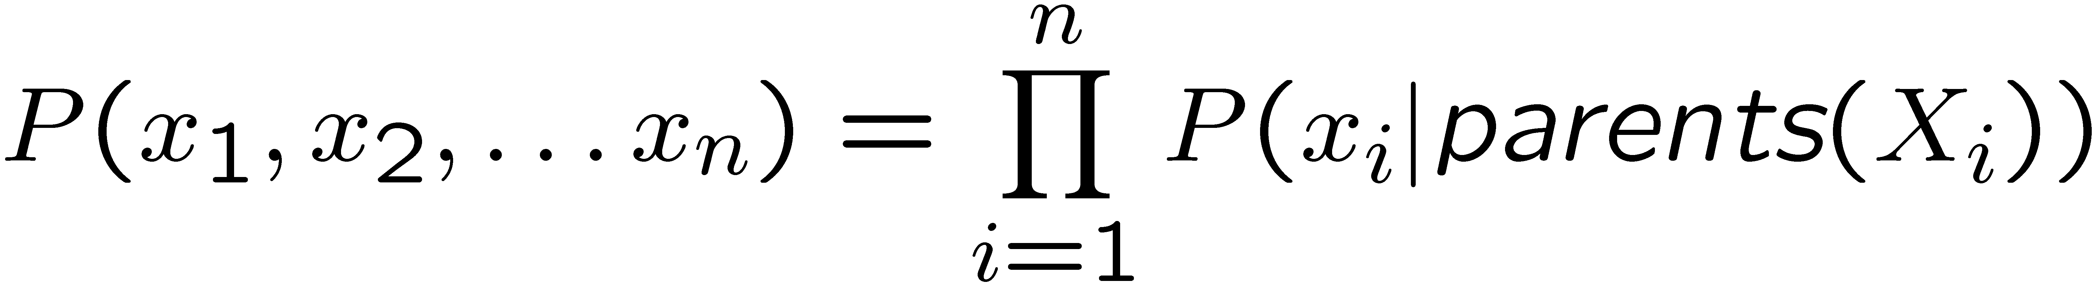
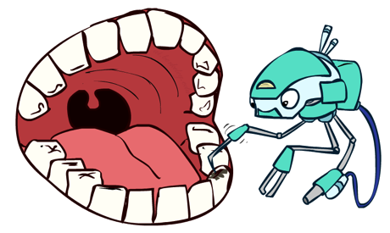
Probabilities in BNs
Bayes’ nets implicitly encode joint distributions
As a product of local conditional distributions
To see what probability a BN gives to a full assignment, multiply all the relevant conditionals together:
Example:
P(+cavity, +catch, -toothache) =
P(+cavity)
P(-toothache | +cavity)
P(+catch | +cavity)

Slide 36
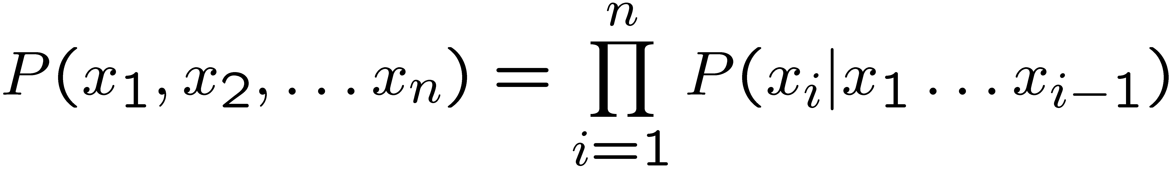
Probabilities in BNs
Why are we guaranteed that setting
results in a proper joint distribution?
Chain rule (valid for all distributions):
Assume conditional independences:
→ Consequence:
Not every BN can represent every joint distribution
The topology enforces certain conditional independencies
Notes:
DAG – topologic sort. Parents before children. Why we need DAG for Baye’s net.
Bayes’ net assumption.
Disconnected assumes indep like coin flips. Rain/traffic/ballgame not like that, but assumes relationships.

Slide 37
Example: Coin Flips
X₁
X₂
X_{n}
h | 0.5
t | 0.5
h | 0.5
t | 0.5
h | 0.5
t | 0.5
P(h, h, t, h) =
P(X₁ = h) P(X₂ = h) P(X₃ = t) P(X₄ = h)
Only distributions whose variables are absolutely independent can be represented by a Bayes’ net with no arcs.
Notes:
None have parents. So just multiply each.

Slide 38
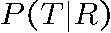

Probability of Rain and No Traffic?
R
+r | 1/4
-r | 3/4
P(+r, -t) =
P(+r) P(-t | +r)
= ¼ * ¼
+r | +t | 3/4
 | -t | 1/4
T
-r | +t | 1/2
 | -t | 1/2

Slide 39

Example: Alarm Network
B | P(B)
+b | 0.001
-b | 0.999
E | P(E)
+e | 0.002
-e | 0.998
Burglary
Earthqk
Alarm
B | E | A | P(A|B,E)
+b | +e | +a | 0.95
+b | +e | -a | 0.05
+b | -e | +a | 0.94
+b | -e | -a | 0.06
-b | +e | +a | 0.29
-b | +e | -a | 0.71
-b | -e | +a | 0.001
-b | -e | -a | 0.999
John calls
Mary calls
A | J | P(J|A)
+a | +j | 0.9
+a | -j | 0.1
-a | +j | 0.05
-a | -j | 0.95
A | M | P(M|A)
+a | +m | 0.7
+a | -m | 0.3
-a | +m | 0.01
-a | -m | 0.99
Notes:
~10:40
Q: What’s highest prob for any joint including +b?
Demo (shoot for 7 minutes).
Bad neighborhood. Right on a fault. Why?

Slide 40

Example: Traffic
Causal direction
R
+r | 1/4
-r | 3/4
+r | +t | 3/16
+r | -t | 1/16
-r | +t | 6/16
-r | -t | 6/16
+r | +t | 3/4
 | -t | 1/4
T
-r | +t | 1/2
 | -t | 1/2

Slide 41
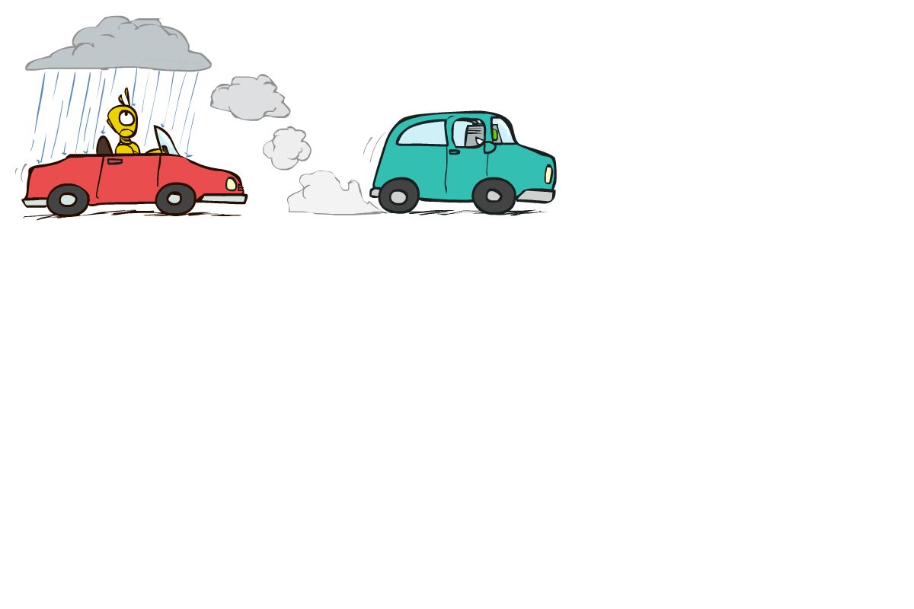
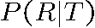
Example: Reverse Traffic
Reverse causality?
T
+t | 9/16
-t | 7/16
+r | +t | 3/16
+r | -t | 1/16
-r | +t | 6/16
-r | -t | 6/16
+t | +r | 1/3
 | -r | 2/3
R
-t | +r | 1/7
 | -r | 6/7
Notes:
Encode same joint.
Notice that cond prob tables not the same.

Slide 42
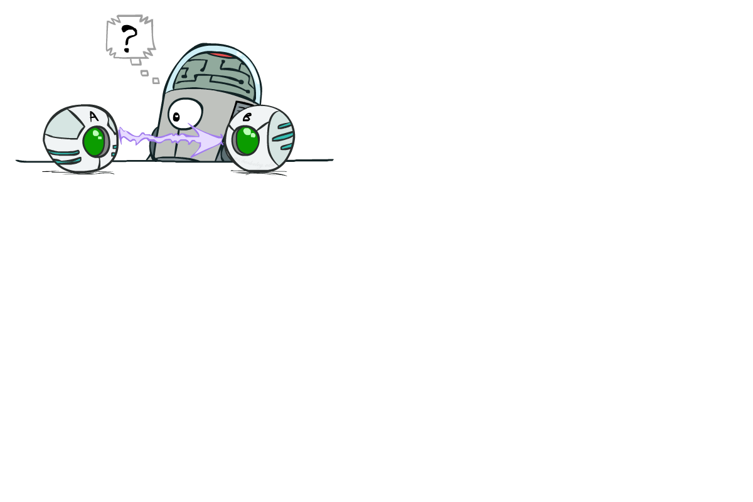
Causality?
When Bayes’ nets reflect the true causal patterns:
Often simpler (nodes have fewer parents)
Often easier to think about
Often easier to elicit from experts
BNs need not actually be causal
Sometimes no causal net exists over the domain (especially if variables are missing)
E.g. consider the variables Traffic and Drips
End up with arrows that reflect correlation, not causation
What do the arrows really mean?
Topology may happen to encode causal structure
Topology really encodes conditional independence
Notes:
Some directions might be easier. P(texting | accident) vs. P(accident | texting)

Slide 43
Bayes’ Nets
So far: How a Bayes’ net encodes a joint distribution
First assembled BNs using an intuitive notion of conditional independence as causality
Then saw that key property is conditional independence
Next lecture: How to answer numerical queries (inference)

